Slide 1
EXCEL AUTOMATION USING RPA
Team Members
1.BARANI.S
2.DEEPIKA.S
3.GOWTHAM.M
4.KISHORE.K
Facultyguide : Industrial guide :Mr.Rajan
Mrs.C.Sangeetha
Assistant professor
Department of CSE
Department of CSE, KGiSL Institute of Technology, Coimbatore

Slide 2
Agenda
Abstract
Objective & Outcome
Introduction
Area introduction - existing system
Proposed System
Literature Review
Architectural Diagram
Flow chart
Data flow diagrams
Module split-up
Screenshots
Department of CSE, KGiSL Institute of Technology, Coimbatore

Slide 3
Abstract
  In our project we are going to do excel automation using RPA. It contains activities that enable you to read information from a cell, columns, rows or ranges, write to other spreadsheets or workbooks, execute macros, and even extract formulas. Our project is about automatically filling the details in the excel sheet to the google form. We now have a nice show case that proves how this kind of automation can lead to more efficient organizations.
Department of CSE, KGiSL Institute of Technology, Coimbatore

Slide 4
Objectives And Outcome
  Objectives:
  The main Objective of the project is to develop a system that automates the process of placement recruitment from the excel data.
  Outcomes:
  The placement recruiter could easily filter the candidates appearing for the placement drive and could judge the performance based on the Graphs and charts.
Department of CSE, KGiSL Institute of Technology, Coimbatore

Slide 5
Introduction of RPA
Robotic Process Automation(RPA) is a software-based technology utilizing software robots to emulate human execution of a business process. RPA captures data, runs applications, triggers responses, and communicates with other systems to perform a variety of tasks - Uipath.
RPA doesn't require programming skills. Employees with any subject expertise can be trained to automate RPA tools instantly.
Department of CSE, KGiSL Institute of Technology, Coimbatore

Slide 6
Any interaction between a human and a computer can be automated. However, processes with repeatable, predictable interactions with IT applications are best suited for RPA. Automation can improve the effectiveness and efficiency of these processes without changing the underlining systems.
Department of CSE, KGiSL Institute of Technology, Coimbatore

Slide 7
Area Introduction-Existing system
Excel automation streamlines our use of the application by automatically performing tasks like formatting cells, updating values, and running macros.
Across businesses of all sizes and across industries, one tool is ubiquitous—the Microsoft Excel spreadsheet.
Automate can automatically execute the same steps you would perform when working with spreadsheets, such as formatting cells or updating values.
Department of CSE, KGiSL Institute of Technology, Coimbatore

Slide 8
Proposed System
The excel automation is used to overcome the entire problem which we are facing currently, and making complete automation of filling details from excel sheet to google form.
The process consists out of the selection of the right data in a excel sheet.
  For the RPA it doesn’t matter that how much data is to be automated.
Set the google form with the necessary details which are given in the excel sheet.
After that we have to attach the browser link in the uipath for the automation.
Department of CSE, KGiSL Institute of Technology, Coimbatore

Slide 9
Literature Review
Drawbacks of existing system
Since when a data file is too large, it can make the excel program run very slowly, especially if all the data is in one file.
In existing model there is no choice of viewing the particular details and statistical analysis like graphs, charts etc.
References
  http://www.edureka.co/blog/uipath-automation
  http://xltools.net/excel-automation/
Department of CSE, KGiSL Institute of Technology, Coimbatore

Slide 10
Architectural Design
Open UI path
START
Filling google form
Main.xslm
Excel Automation
Proceed charts from excel sheet
Filtering detais
Department of CSE, KGiSL Institute of Technology, Coimbatore

Slide 11
Flow Chart
Start
Student Details
Excel Entry
Automate The Excel
Google Form Creation
Chart process
Filtering details
Stop
Department of CSE, KGiSL Institute of Technology, Coimbatore

Slide 12
Data Flow Diagram Level 0
Student Details
fetchdata
Pre-Placement cell
Excel
entry
Department of CSE, KGiSL Institute of Technology, Coimbatore

Slide 13
Data Flow Diagram Level 1
Student details
Collected
Management
Send
Pre-Placement Cell
Entry
Google Form
Automate
Ui Path
Attach
Excel
Department of CSE, KGiSL Institute of Technology, Coimbatore

Slide 14
Module Splitup
Module I:
  Create a google form.
  Attach a link to Ui-path.
Module II:
  Create a excel sheet and automate the details from excel sheet to google form.
Module III:
Convert the details in excel sheet as graphs, charts etc.
Module IV:
  Filtering the particular data in the excel sheet and view it.
Department of CSE, KGiSL Institute of Technology, Coimbatore

Slide 15
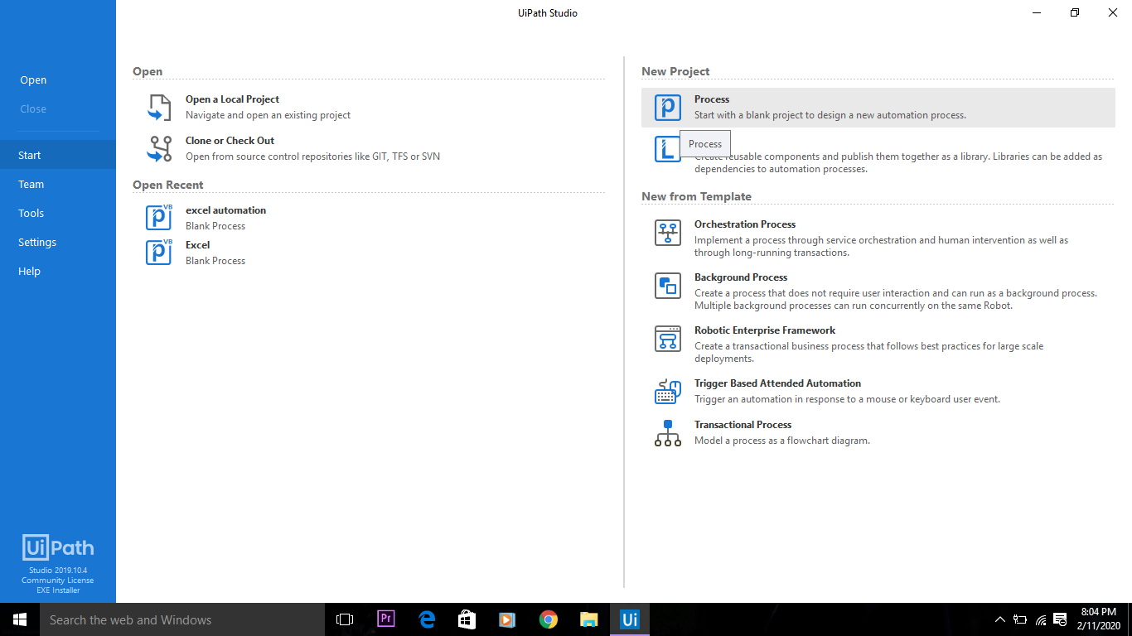
Screen shots of modules under progress.
Department of CSE, KGiSL Institute of Technology, Coimbatore

Slide 16
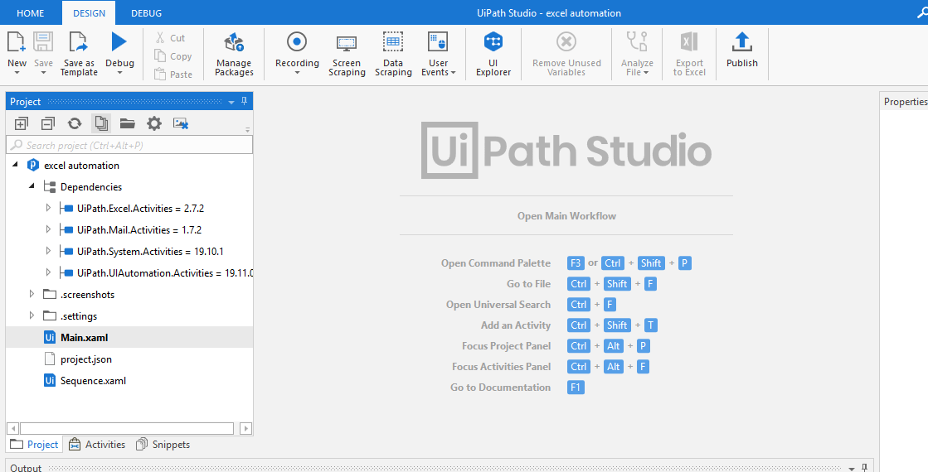
Get Information:
Department of CSE, KGiSL Institute of Technology, Coimbatore

Slide 17
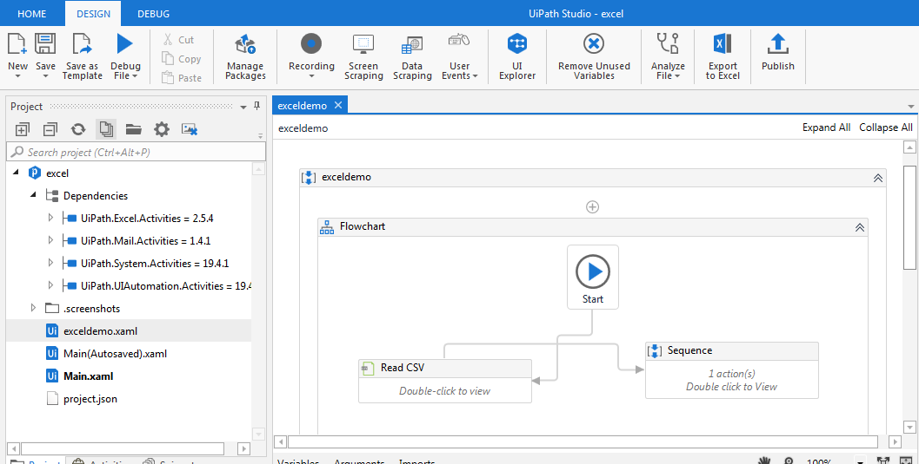
Sequence:
Sequence flow for google form
Department of CSE, KGiSL Institute of Technology, Coimbatore

Slide 18
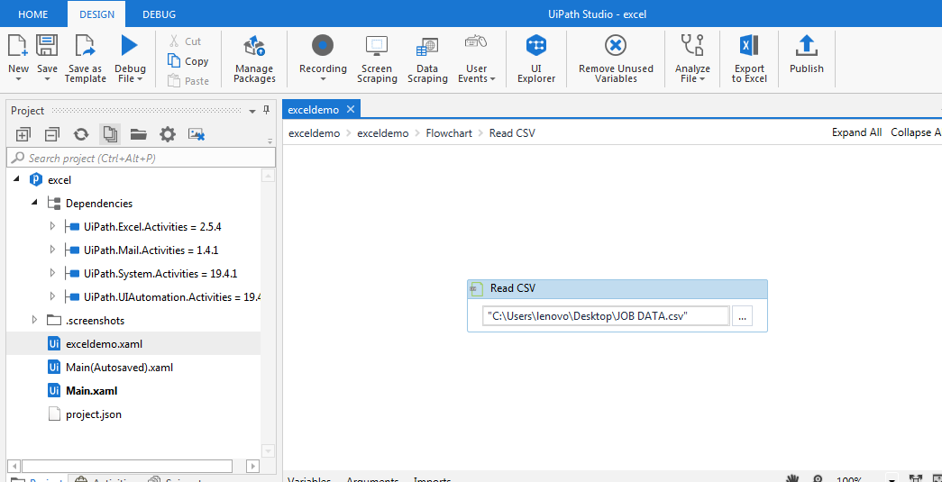
Reading excel sheet:
Department of CSE, KGiSL Institute of Technology, Coimbatore

Slide 19
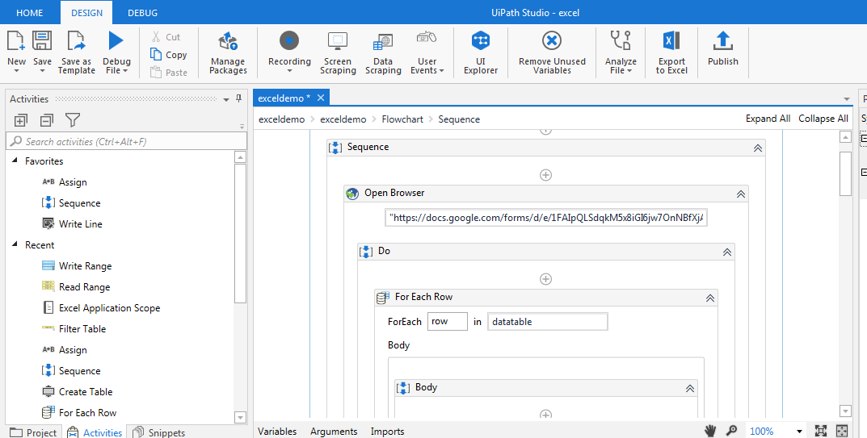
Sequence:
Department of CSE, KGiSL Institute of Technology, Coimbatore

Slide 20
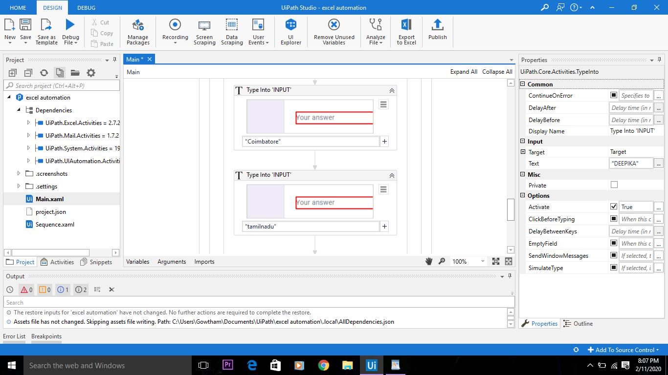
Sequence
Details
Department of CSE, KGiSL Institute of Technology, Coimbatore

Slide 21
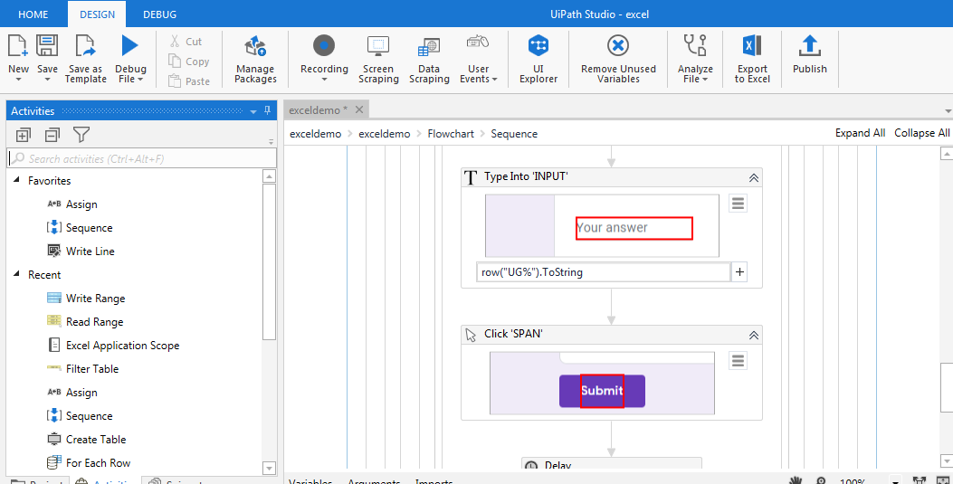
Sequence
Department of CSE, KGiSL Institute of Technology, Coimbatore

Slide 22
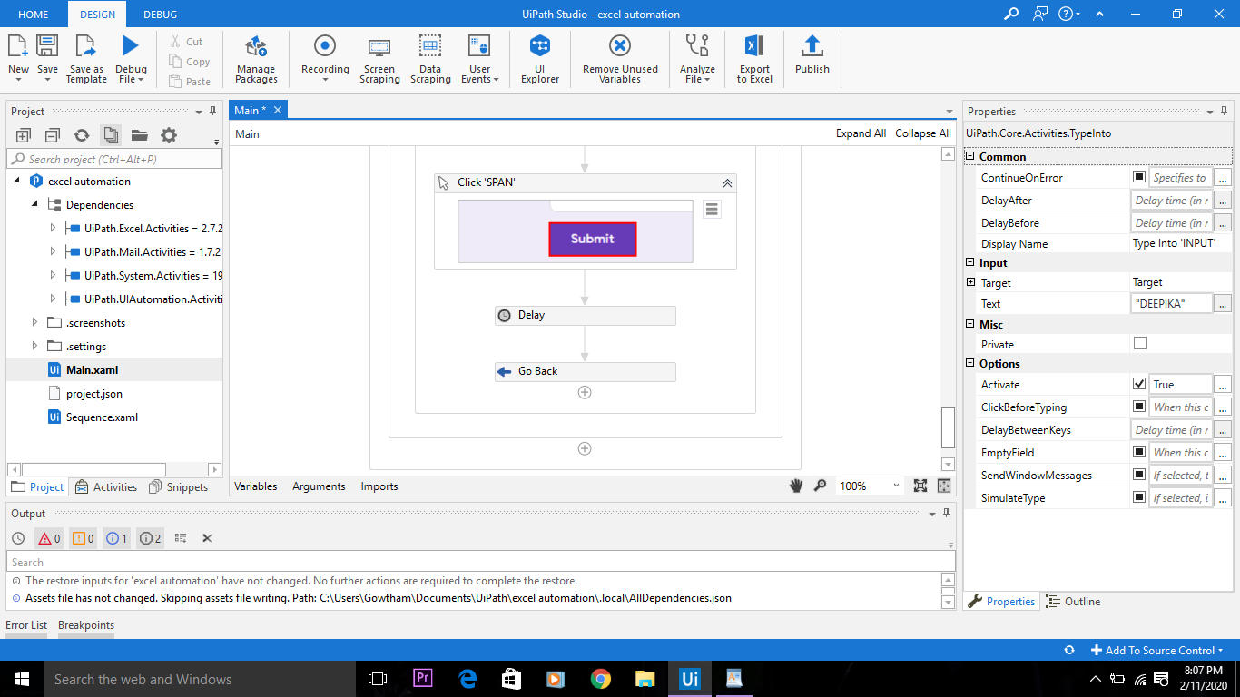
Submit
submit
Department of CSE, KGiSL Institute of Technology, Coimbatore

Slide 23
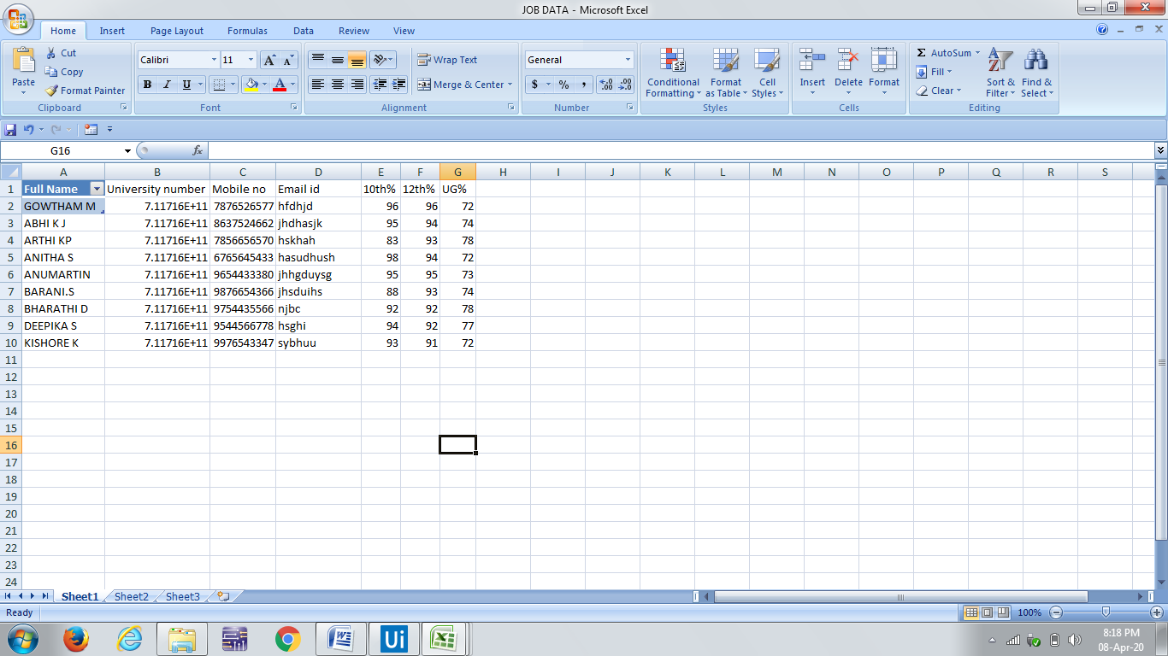
Excel details
Department of CSE, KGiSL Institute of Technology, Coimbatore

Slide 24
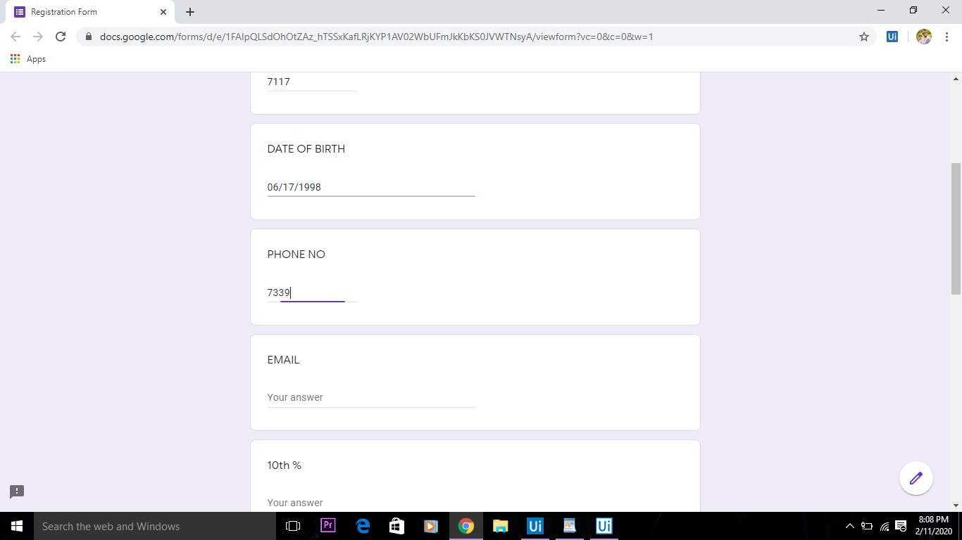
Output
Department of CSE, KGiSL Institute of Technology, Coimbatore

Slide 25
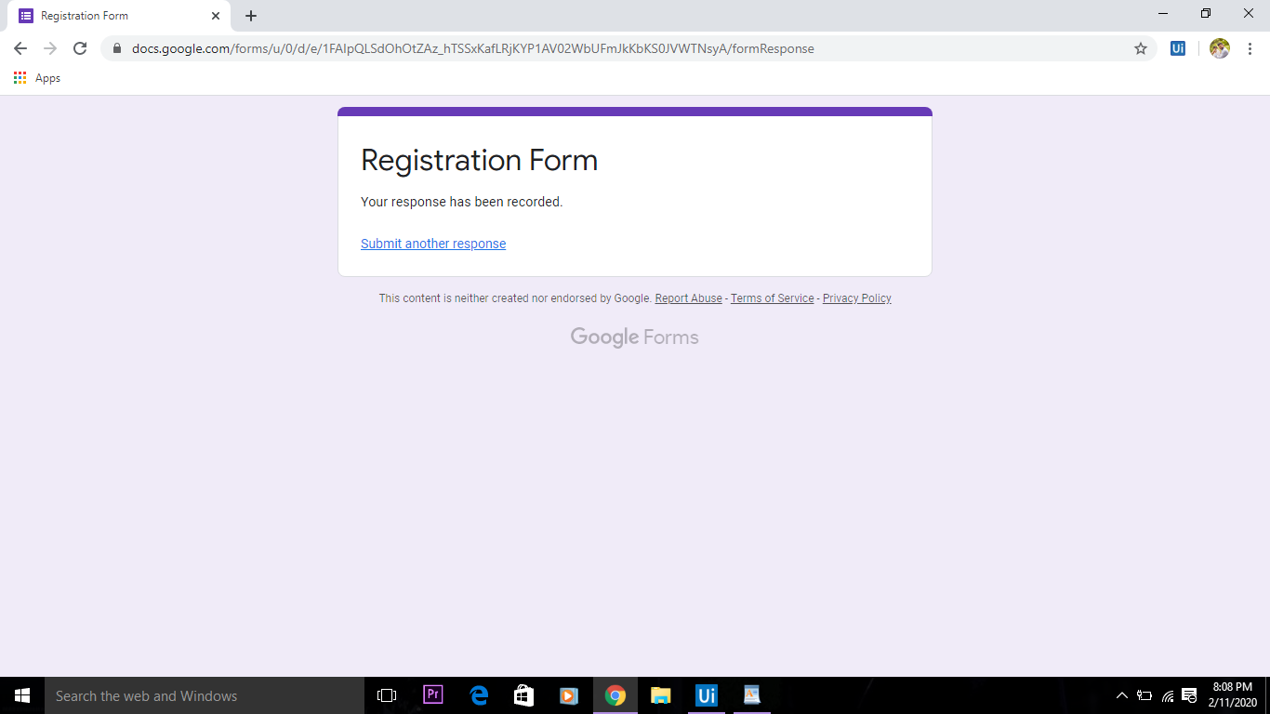
Output
Department of CSE, KGiSL Institute of Technology, Coimbatore

Slide 26
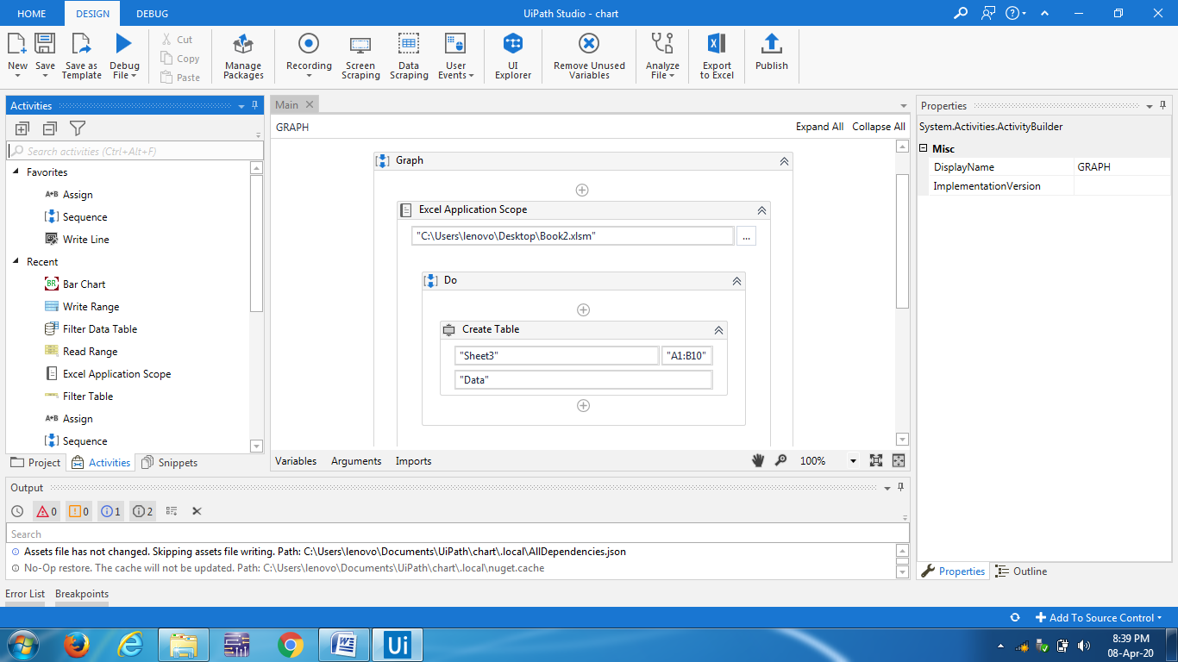
Chart process:
Department of CSE, KGiSL Institute of Technology, Coimbatore

Slide 27
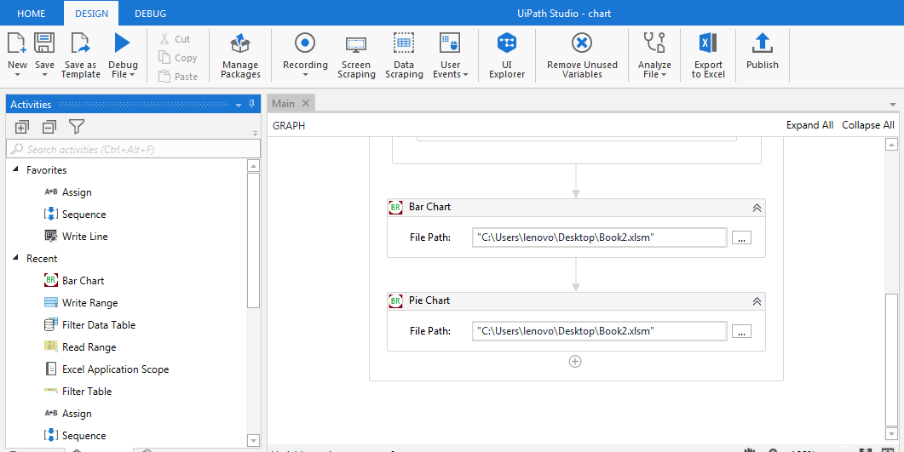
Sequence
Department of CSE, KGiSL Institute of Technology, Coimbatore

Slide 28
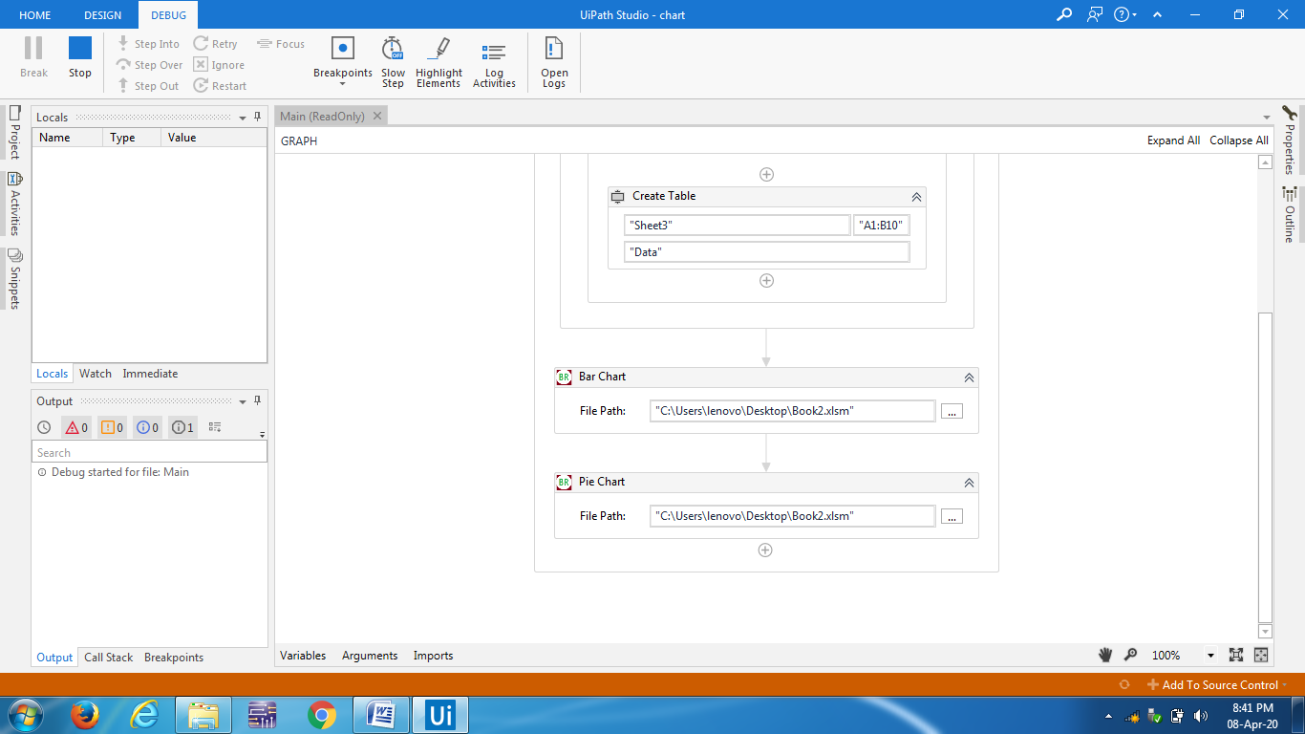
Sequence
Department of CSE, KGiSL Institute of Technology, Coimbatore

Slide 29
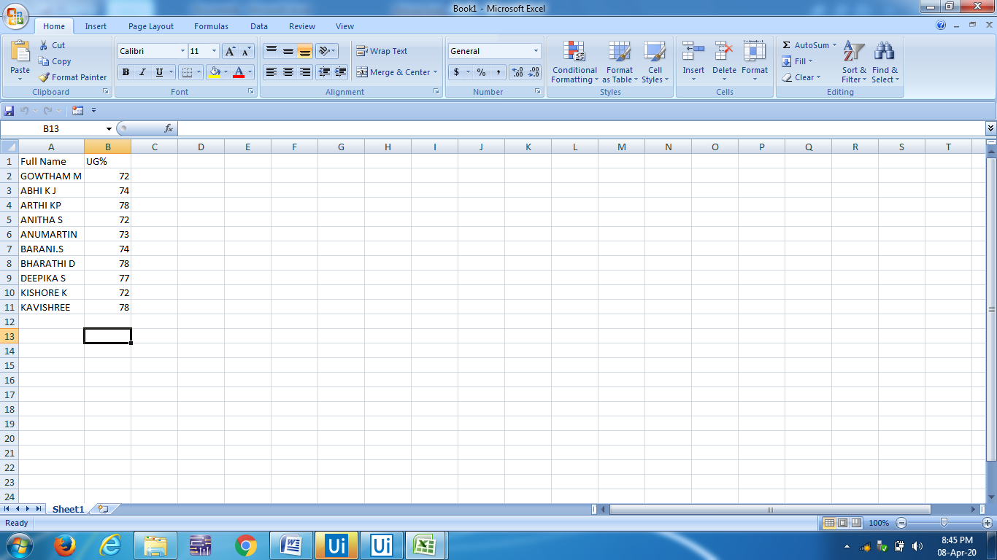
Excel details
Department of CSE, KGiSL Institute of Technology, Coimbatore

Slide 30
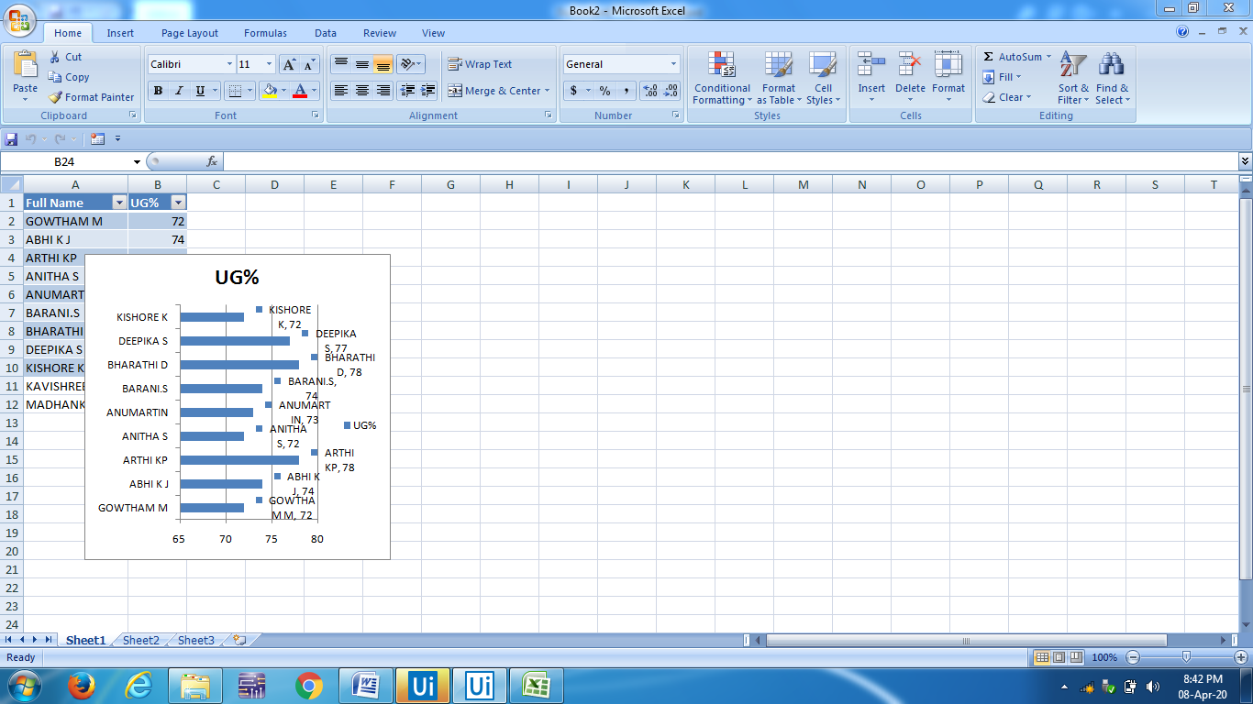
Output:
Department of CSE, KGiSL Institute of Technology, Coimbatore

Slide 31
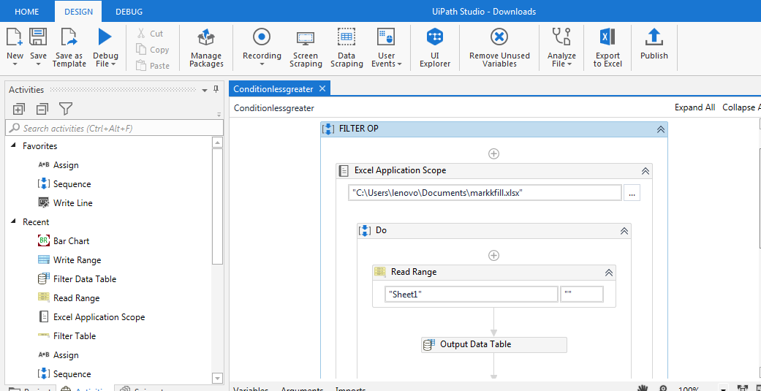
Filtering
Department of CSE, KGiSL Institute of Technology, Coimbatore

Slide 32
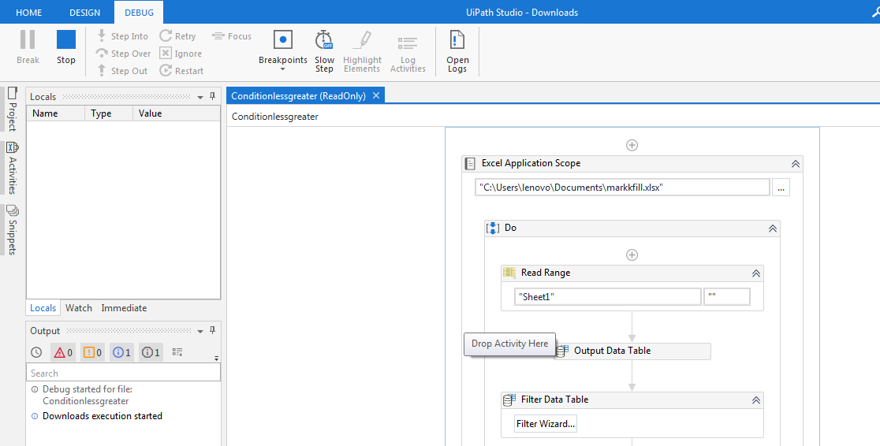
Sequence
Department of CSE, KGiSL Institute of Technology, Coimbatore

Slide 33
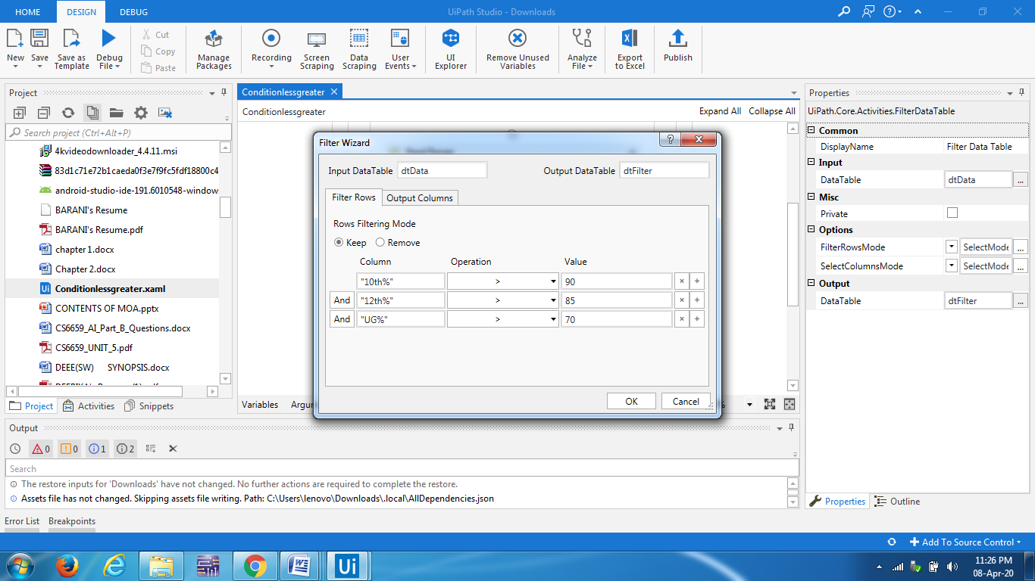
Filter data table
Department of CSE, KGiSL Institute of Technology, Coimbatore

Slide 34
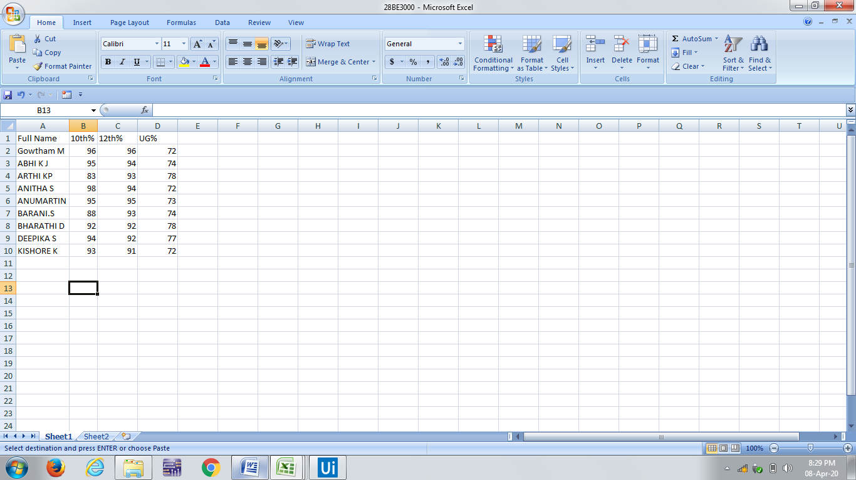
Excel details
Department of CSE, KGiSL Institute of Technology, Coimbatore

Slide 35
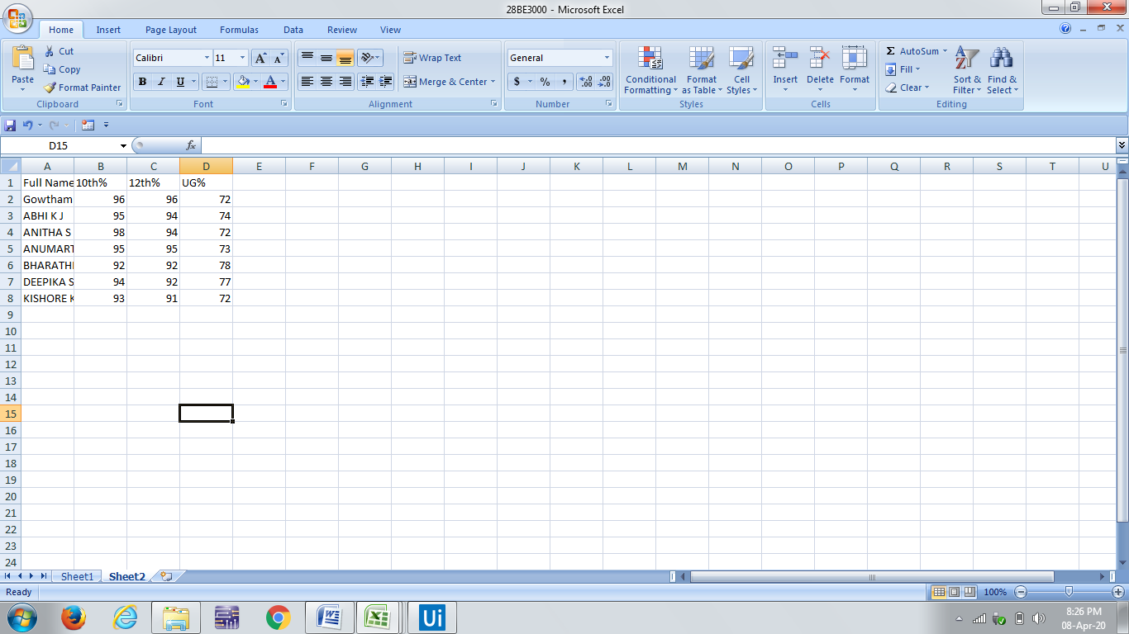
Output:
Department of CSE, KGiSL Institute of Technology, Coimbatore

Slide 36
THANK YOU!
Department of CSE, KGiSL Institute of Technology, Coimbatore

